Slide 1
Increased difficulties in adjusting to school life due to COVID-19 (communication with friends, club activities, practice classes, etc.)
-> The demand of people who want to have a similar experience as offline in the online space is increasing
-> You can increase access to various smart campus facilities through the Hub and experience real school life online

Slide 2
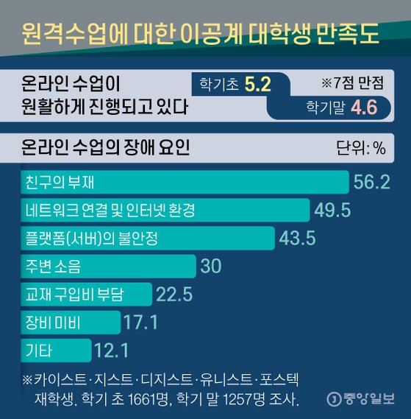
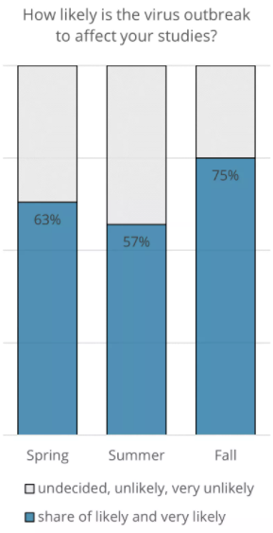
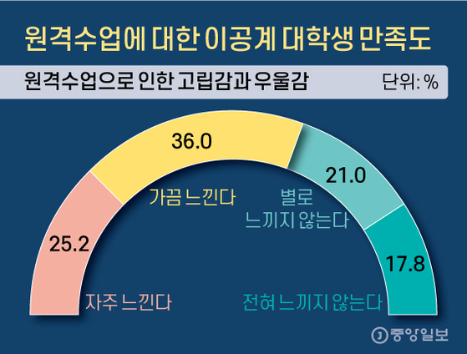
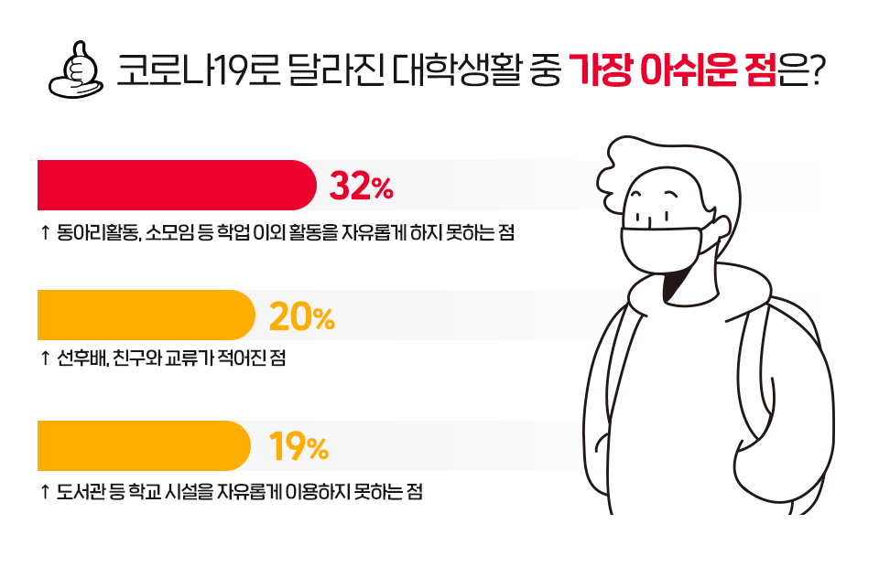
Results of survey from students. (Spring: 881 responses, Summer: 682 responses, Fall: 889 responses)
(Studyportals, 2020)
The most disappointing thing about college life that has changed due to COVID-19
(SK Insight,2020)

Slide 3
Many college students are not satisfied with their school life due to the corona virus.
Due to distance learning, the quality of learning decreases and people feel depressed and isolated.
It is inconvenient to not be able to freely use school facilities.

Slide 4
Metabus in Campus
동신대 메타버스 강의 도입- https://www.dsu.ac.kr/kr/?pCode=dsunews&mode=view&idx=17150
->A metaverse format focused only on the lecture itself
순천향대 메타버스 입학식 - https://www.youtube.com/watch?v=1A559Hcr90g
->Short-term metaverse event applied only to the entrance ceremony
건국대 메타버스 축제 - https://www.youtube.com/watch?v=SAcfSbxcrVU
->Short-term metaverse event applied only to the festival

